Slide 1
GAN
(Generative Adversarial Network)

Slide 2
GAN(Generative Adversarial Network)
Generative Adversarial Network
적대적 생성 모델
생성모델 (Generative model) – 그럴듯한 가짜(실제 데이터 분포와 근사)
적대적 (Adversarial) – 두 개의 모델을 적대적으로 경쟁시키며 발전
두 개의 모델 – 생산자(Generator), 판별자(Discriminator)
Generator -> make fake like real, Discriminator -> discriminate real and fake
네트워크 (Network) – 인공신경망 또는 딥러닝으로 만들어졌기 때문

Slide 3
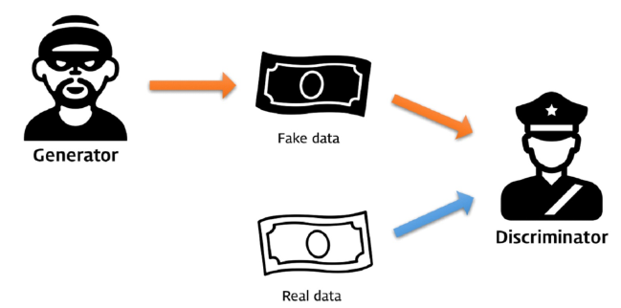
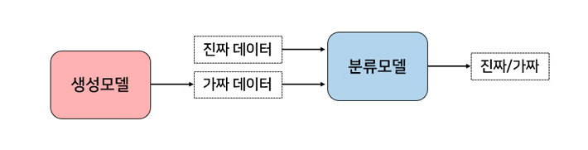
Concept
2 Player간의 Game
P1: 화폐 위조범(Generator), P2: 경찰(Discriminator)

Slide 4
Network Principle
Generator
Random noise vector ‘z’ -> make fake image
Fake image -> Discriminator
Feedback from Discriminator
Contrary convolution network(up sampling)
Discriminator
Discriminate real and fake
Return real(:1), fake(:0)
Feedback from Ground Truth
Normal convolution network(down sampling)

Slide 5
Loss
Loss (=error)
모델의 예측과 정답 사이에 얼마나 차이가 있는지 나타내는 측도
GAN Loss
Discriminator Loss (Loss D)
Generator Loss (Loss G)

Slide 6
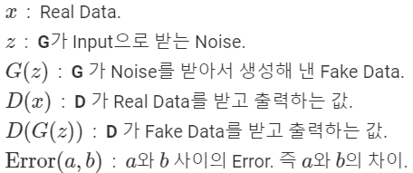

Loss
Loss D
LossD = Error(D(x), 1) + Error(D(G(z)), 0)
D는 real일 때 1, fake일 때 0 출력하도록
Maximize D
Loss G
LossG = Error(D(G(z)), 1)
G는 D가 fake를 1로 출력하도록 // Real은 어떻게 판단하는지 상관 X
Minimize D
Error(p, t) – cross entropy error
Error(p, t)=−t log(p) − (1−t) log(1−p)

Slide 7
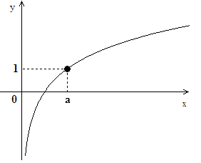
Loss
Input (1,1)
Error(1, 1)=−1 log(1) − (1−1) log(1−1) = -log(1) = 0
Input (1,0)
Error(1, 0)=−0 log(1) − (1−0) log(1−1) = -log(0) = infinity
Input (0,1)
Error(0, 1)=−1 log(0) − (1−1) log(1−0) = -log(0) = infinity
Input (0,0)
Error(0, 0)=−0 log(0) − (1−0) log(1−0) = -log(1) = 0

Slide 8
GAN(Generative Adversarial Network)
Loss
LossD = −log(D(x)) − log(1−D(G(z)))
Maximize D
LossG = −log(D(G(z)))
Minimize D
Minmax problem

Slide 9



GAN(Generative Adversarial Network)
Code

Slide 10
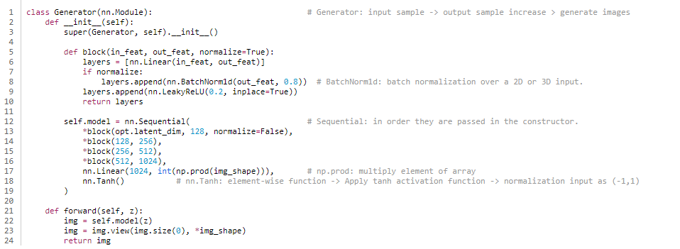
GAN(Generative Adversarial Network)
Code

Slide 11
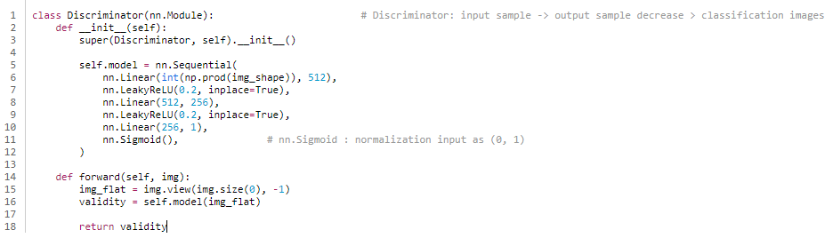
GAN(Generative Adversarial Network)
Code

Slide 12
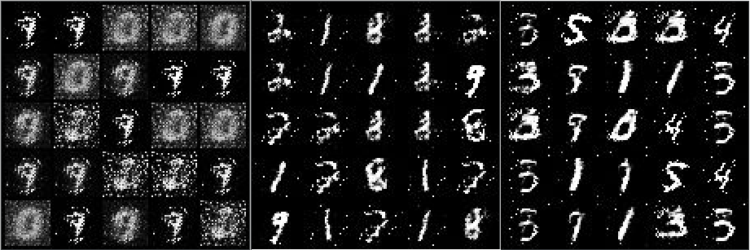
GAN(Generative Adversarial Network)
Result

Slide 13
Reference
https://www.samsungsds.com/global/ko/support/insights/Generative-adversarial-network-AI-2.html
https://dreamgonfly.github.io/2018/03/17/gan-explained.html
https://pathmind.com/kr/wiki/generative-adversarial-network-gan
https://yamalab.tistory.com/98
http://jaejunyoo.blogspot.com/2017/01/generative-adversarial-nets-1.html

